Slide 1


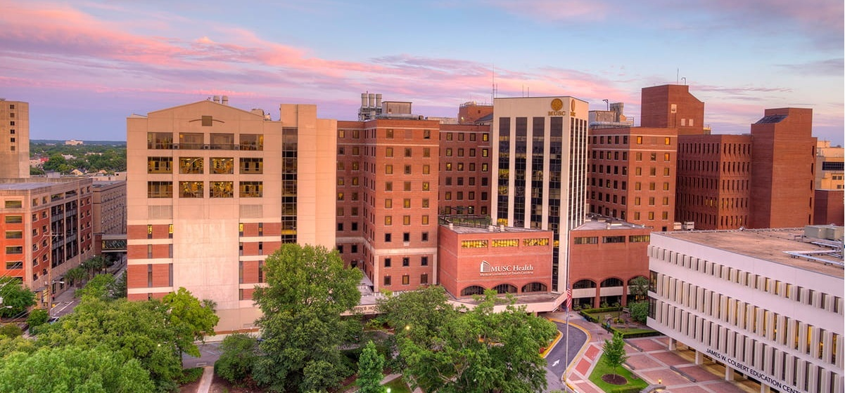
MUSC-SPONSORED STATEWIDE DTE HEALTH PLAN
October 14, 2024

Slide 2



Founded in 1979 and headquartered in Indianapolis, IN​
Full-service TPA specializing in the administration of self-funded health plans and population health management​
One of the country’s largest independently-owned TPAs
The Key Family is a commonly-held group of benefits related organizations with:​
3,000+ corporate clients​
3.0 million members under management​
700 Employees
Exclusive Relationships
We know The Market – Agents, Networks, and MGAs

Slide 3


Market Leader in Private Labeled DTE Plans
Louisville, KY
OneHealth Plan
Cincinnati, OH
TCH Optimal
Bentonville, AR
Northwest Health Plan
Knoxville, TN
East Tennessee Health Plan
Meridian, MS
Affinity Health Plan
Fort Myers, FL
Lee Health Care Partners

Slide 4

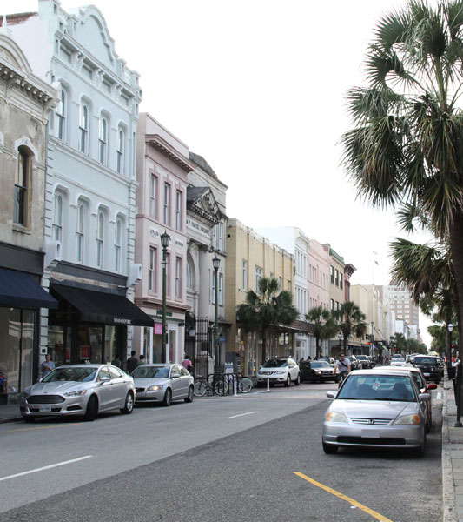
Moving Local Healthcare
From Wall Street to Main Street

Slide 5

When Healthcare Providers Control Their Health Plan
YOU Pick the Name of the Health Plan
YOU Determine the Fees Charged
YOU Practice the Medicine
YOU Receive the Profits
WE Make it Successful

Slide 6
Plan Overview
MUSC controls the plan and invites other provider organizations to participate.
KBA facilitates the plan to ensure success.
All plan members will see within-plan market share growth.
Net margins are comparable to commercial plans—prices are 10% below current commercial rates, but friendlier payment policies and higher patient collection rates through the healthcare credit card ensure comparable net margin to other commercial rates.

Slide 7
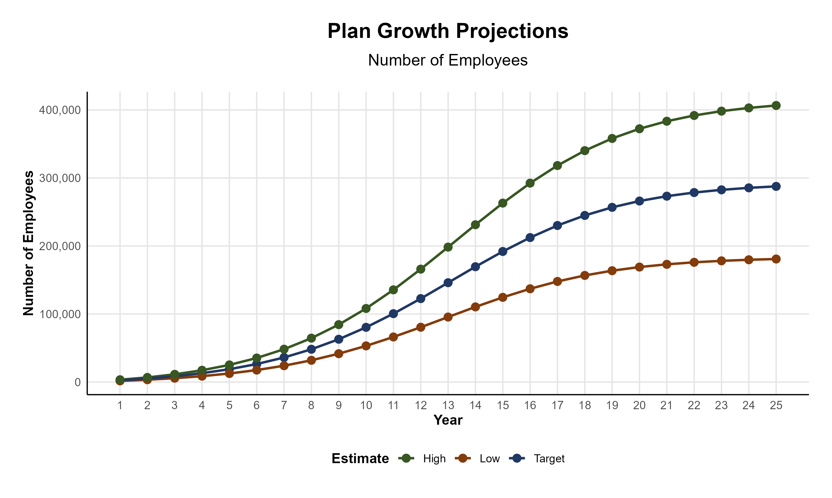
Plan Potential Growth Paths
Self Funded
1,271K
PLAN GROWTH POTENTIAL
1,962K
Insured
Working Age
2,950K
Population
5,143K
Estimates include all of South Carolina

Slide 8
Plan Steerage Growth Projections
Health System | Current Inpatient Market Share | Current Outpatient Market Share | Within-Plan Expected Inpatient Market Share | Within-Plan Expected Outpatient Market Share
Medical University of South Carolina Health System | 21.11% | 8.71% | 26.20% | 16.39%
Bon Secours Mercy Health | 7.31% | 4.82% | 12.84% | 12.84%
Lexington Medical Center | 7.14% | 4.36% | 10.84% | 10.03%
HCA Healthcare | 9.41% | 2.58% | 9.74% | 4.05%
Spartanburg Regional Healthcare System | 7.24% | 4.09% | 8.72% | 7.47%
McLeod Health | 6.83% | 3.63% | 7.76% | 6.25%
AnMed Health System | 3.44% | 1.61% | 5.32% | 3.78%
Prisma Health | 24.22% | 11.61% | 4.13% | 6.27%
Novant Health | 2.67% | 1.17% | 2.76% | 1.83%
Tenet Healthcare | 2.60% | 0.83% | 2.71% | 1.31%
Self Regional Healthcare | 2.11% | 1.33% | 2.67% | 2.55%
Universal Health Services | 1.61% | 0.53% | 1.67% | 0.83%
Tidelands Health | 1.57% | 1.16% | 1.62% | 1.82%
Conway Medical Center | 1.19% | 0.82% | 1.23% | 1.28%
Beaufort Memorial Hospital | 0.85% | 1.02% | 0.88% | 1.60%
ScionHealth | 0.40% | 0.30% | 0.43% | 0.49%
Newberry County Memorial Hospital | 0.18% | 0.20% | 0.32% | 0.53%
Abbeville Area Medical Center | 0.05% | 0.17% | 0.08% | 0.40%
Hampton Regional Medical Center | 0.05% | 0.11% | 0.05% | 0.17%
Allendale County Hospital | 0.02% | 0.06% | 0.02% | 0.09%
Market share growth modeled by zip code, projecting where patients would go if Prisma Health and some community (unaffiliated) physicians are not included in the network.

Slide 9
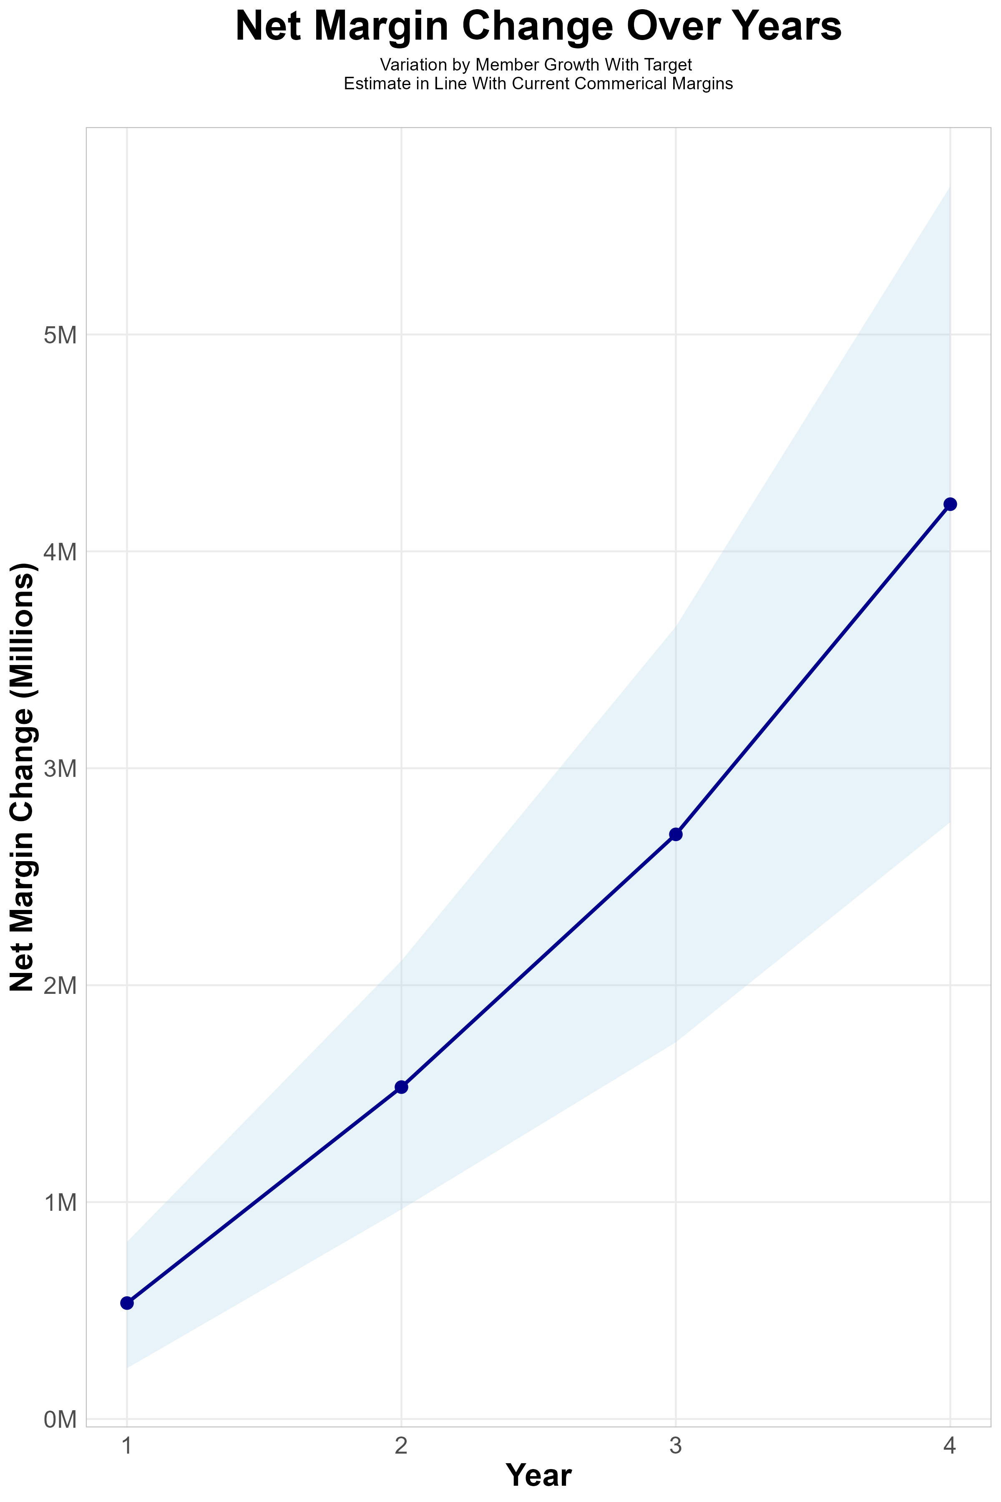
FOUR-YEAR PROJECTIONS
Target Member Growth | Target Member Growth | Target Member Growth | Target Member Growth | Target Member Growth
Metric | Year 1 | Year 2 | Year 3 | Year 4
Number of Members | 4,600 | 9,100 | 15,300 | 23,400
Incremental Margin | 809.3K | 1,601.0K | 2,691.7K | 4,116.8K
Network Access Fee | 55.2K | 109.2K | 183.6K | 280.8K
Implementation Fee (One-Time) | -150.0K | 0.0K | 0.0K | 0.0K
Sales and Marketing Costs | -180.0K | -180.0K | -180.0K | -180.0K
Net Margin Change | 534.5K | 1,530.2K | 2,695.3K | 4,217.6K
High Member Growth | High Member Growth | High Member Growth | High Member Growth | High Member Growth
Metric | Year 1 | Year 2 | Year 3 | Year 4
Number of Members | 6,100 | 12,200 | 20,400 | 31,200
Incremental Margin | 1,073.2K | 2,146.4K | 3,589.0K | 5,489.0K
Network Access Fee | 73.2K | 146.4K | 244.8K | 374.4K
Implementation Fee (One-Time) | -150.0K | 0.0K | 0.0K | 0.0K
Sales and Marketing Costs | -180.0K | -180.0K | -180.0K | -180.0K
Net Margin Change | 816.4K | 2,112.8K | 3,653.8K | 5,683.4K
Low Member Growth | Low Member Growth | Low Member Growth | Low Member Growth | Low Member Growth
Metric | Year 1 | Year 2 | Year 3 | Year 4
Number of Members | 3,000 | 6,100 | 10,200 | 15,600
Incremental Margin | 527.8K | 1,073.2K | 1,794.5K | 2,744.5K
Network Access Fee | 36.0K | 73.2K | 122.4K | 187.2K
Implementation Fee (One-Time) | -150.0K | 0.0K | 0.0K | 0.0K
Sales and Marketing Costs | -180.0K | -180.0K | -180.0K | -180.0K
Net Margin Change | 233.8K | 966.4K | 1,736.9K | 2,751.7K

Slide 10
Year 4 Projected Revenue and Profit
Pre-DTE Cohort of 23,400 Employees | Inpatient | Outpatient | Professional | Total
Revenue† | $ 15,786,150 | $ 11,833,469 | $ 5,526,129 | $ 33,145,748
Net Income‡ | $ 3,157,230 | $ 2,366,694 | $ 1,105,226 | $ 6,629,150
† Assuming proportional revenues from market shares of 21% (inpatient) and 9% (outpatient)
‡ Conservatively assuming a commercial margin of 20% (80% of the estimated commercial margin)
With DTE | Inpatient | Outpatient | Professional | Total
Revenue⁰ | $ 19,601,759 | $ 22,306,769 | $ 10,417,072 | $ 52,325,600
Net Income* | $ 3,920,352 | $ 4,461,354 | $ 2,083,414 | $ 10,465,120
⁰ Assuming 26% inpatient and 16% market steerage based on KBA narrow network DTE experience (see previous slide)
* Conservatively assuming a commercial margin of 20%, with a 10 percentage-point reduction to reflect competitive-edge rates and a 10 percentage-point increase to reflect lower billing costs and better patient-responsibility collections because of the plan patient card.
Total Increase in Net Income | $ 3,835,970
Network Access Fee (Revenue) of $1 PMPM | $ 280,800
Total Profit Growth | $ 3,840,770
Minus Implementation Fee (One-Time) | -$ 0
Minus Sales and Marketing (Annual – Ongoing) | -$ 180,000
Total | $ 3,936,770

Slide 11

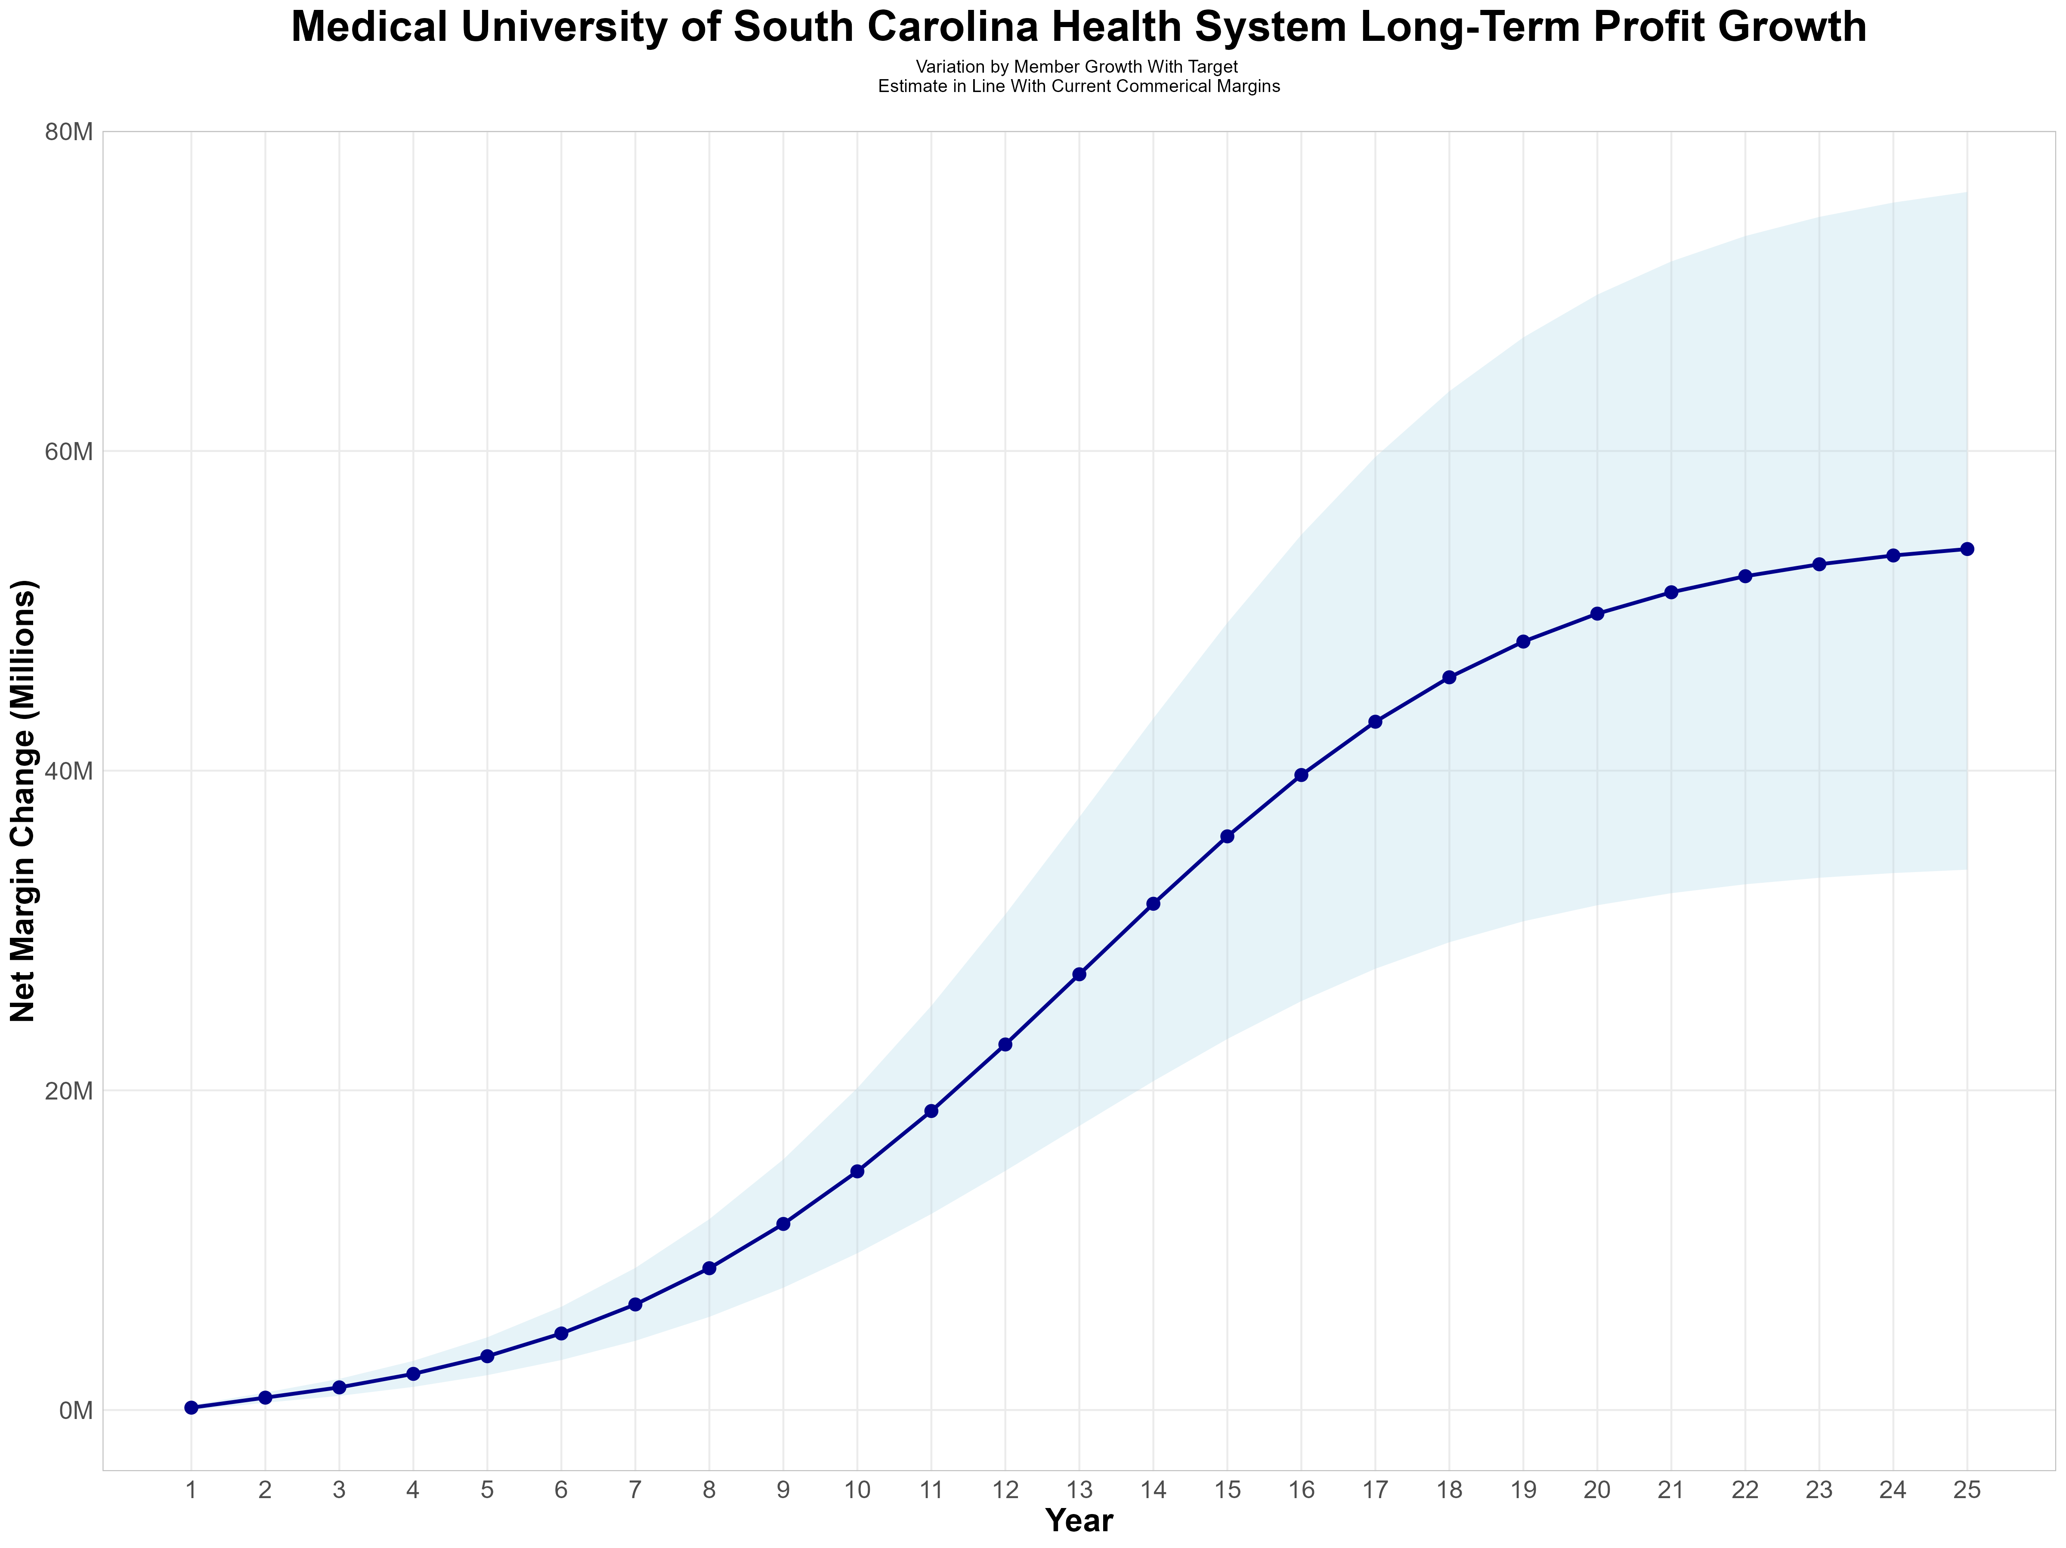
Long-Term Revenue and Profit Growth
Early Stage
Gaining Name Recognition, Early Growth
New Revenue:
New Profit:
$16.25M
$3.53M
Growth Stage
Strong Reputation, Strong Growth
New Revenue:
New Profit:
$111.29M
$25.34M
Mature Stage
High Profitability, Market Saturation
New Revenue:
New Profit:
$219.04M
$50.04M

Slide 12

the missing piece to population health success
Patient engagement is the failure point of population health efforts. Direct employer participation and MUSC’s clinical leadership is key to driving patient engagement.
KBA’s DTE strategy positions Medical University of South Carolina Health System to grow commercial market share by reducing per-employee plan costs even further at a time when employers are desperate for a path to better value.
Medical University of South Carolina Health System can demonstrate greater completion rates for Standards of Care for the Chronically Ill, driving better care & cost outcomes.
Adding MUSC’s managed care processes to KBA’s patented care management programs will turbocharge results – Positioning MUSC as a transformational population health leader.
Medical University of South Carolina Health System CAN PROMOTE THESE RESULTS FROM DAY ONE!!

Slide 13

CHRONIC CONDITION | MINIMUM ANNUAL CARE RECOMMENDED
ASTHMA | 2 Clinical Evaluations 1 Spirometry (for patients 10 years of age or older)
ATRIAL FIBRILLATION | 1 Clinical Evaluation
CHRONIC OBSTRUCTIVE PULMONARY DISEASE | 1 Clinical Evaluation 1 Spirometry
CHRONIC VENOUS THROMBOTIC DISEASE previously listed as Thrombo-embolic Disease | 1 Clinical Evaluation
COPD WITH PULMONARY HYPERTENSION/COR PULMONALE | 2 Clinical Evaluations 12 months of supplemental 02 Tx
CHRONIC KIDNEY DISEASE | 1 Clinical Evaluation 1 Hgb or Hcrt | 1 Serum Creatinine 1 Serum Potassium | 1 Serum Calcium 1 Serum Phosphorus
CONGESTIVE HEART FAILURE | 1 Clinical Evaluation | 1 Serum Creatinine | 1 Serum Potassium
CORONARY ARTERY DISEASE | 1 Clinical Evaluation | 1 LDL
DEPRESSION | 1 Clinical Evaluation
DIABETES | 2 Clinical Evaluations 2 Glycohemoglobins 1 Serum Creatinine | 1 Lipid Panel IF no nephropathy Dx or ACE/ARB Rx, 1 Urine Albumin/Creatinine ratio, Total Protein
EPILEPSY | 1 Clinical Evaluation
HUMAN IMMUNODEFICIENCY VIRUS INFECTION | 2 Clinical Evaluations 2CBCs I T-Cell/CD-4 Count | 2 HIV Quantifications 1 Pap Smear (for women only, 21 years of age or older)
Hyperlipidemia | 1 Lipid Panel
HYPERTENSION | 1 Clinical Evaluation | 1 Serum Creatinine
HYPERTHYROIDISM | 1 Clinical Evaluation | 1 TSH | 1 T4
HYPOTHYROIDISM | 1 Clinical Evaluation | 1 TSH
METABOLIC SYNDROME | 1 Clinical Evaluation | 1 Lipid Panel | 1 FBS or HgbA1c
MULTIPLE SCLEROSIS | 1 Clinical Evaluation
PARKINSON'S DISEASE | 1 Clinical Evaluation
PERIPHERAL ARTERIAL DISEASE (ATHEROSCLEROSIS] previously listed as Peripheral Vascular Disease | 1 Clinical Evaluation 1 LDL
PRE-DIABETES | 1 Clinical Evaluation | 1 Lipid Panel | 1 FBS or HgbA1c
POLYMYALGIA RHEUMATICA | 2 Clinical Evaluation | 2 ESR or CRP | 1 CBC
PULMONARY HYPERTENSION (UNRELATED TO COPD) | 2 Clinical Evaluation
REGIONAL ENTERITIS (INFLAMMATORY BOWEL DISEASE) | 1 Clinical Evaluation
RHEUMATOID ARTHRITIS | 1 Clinical Evaluation
SLEEP APNEA | 1 Clinical Evaluation
ULCERATIVE COLITIS (INFLAMMATORY BOWEL DISEASE) | 1 Clinical Evaluation
INTEGRATION WITH EPIC EHR SYSTEM
CHRONIC DISEASE MANAGEMENT
The chronic diseases identified include a list of services (i.e. exams, lab work and diagnostics) rendered by a network provider payable at 100% and not subject to the deductible or copay.
KBA shares evidence-based standards of care for 27 chronic conditions directly into Epic.

Slide 14

Transparent PBM Integration
Support of MUSC’s retail pharmacy(s)
Optimize MUSC’s 340B drug pricing program
Allows MUSC to create its own PBM program if desired
Custom telephone number with personalized scripting and separate call tracking & reporting
Fully customizable member welcome booklet & materials
White labeled formulary document and marketing materials
CUSTOM CLIENT SUPPORT:
Specialized call center capabilities
Fully customizable plan designs
Operational access to the platform
Customized process and functions to promote DTE strategy
CLINICAL FLEXIBILITY:
Full portfolio of custom formulary offerings – with optimized formulary shield
Clinical programs that drive towards overall DTE strategy
Options for additional drug savings by driving members to lower cost alternatives
Flexibility to customize or layer on utilization management programs

Slide 15
STOP-LOSS INSURANCE
Tokio Marine
Nationwide
Berkshire Hathaway
Sun Life
Liberty Mutual
Granular (Google)
Companion Life
Crum & Forster
American Fidelity
RGA
KBA has over 20 stop-loss underwriters and carriers that we work with on core employer sponsored plans and DTE health plans;
KBA performs a comprehensive analysis of each stop-loss partner to approve them for our business;
KBA provides comprehensive pricing and medical service analysis for each DTE health plan to ensure proper pricing;
KBA is also evaluated by the stop-loss markets to be an approved claims payer for them;
KBA provides the administration required of the stop-loss markets:
Bordereau Reporting;
Claim Reporting and Reconciliation;
Evaluation of Networks;
Care Management;
Initial Underwriting;
Negotiation of rates and terms; and
Plan Design Actuarial

Slide 16

DTE PROGRAM MARKETING & SALES
KBA WORKS WITH YOU TO MANAGE & SELL:
Branding & Messaging
Direct & Brokerage Sales Distribution – Focused Sales Representative
Brochures, Web Site, Media, etc.
Stop-Loss/Level Funded Down to 20 EE Lives
Sell Through Established Brokers in Your Service Area

Slide 17

Complete Sales Distribution System
BROKER DEVELOPMENT
DIRECT SALES
SALES ADMINISTRATION
Identification of Key Distribution Agents
Training and Development
Quote Evaluation
Compensation
Identification of Key Targets
Working with MUSC to Engage Specific Employers
Meet and Greet
Sales Process
Closing
Quote System
Proposal Development
Stop Loss Negotiations
Reporting & Analysis

Slide 18
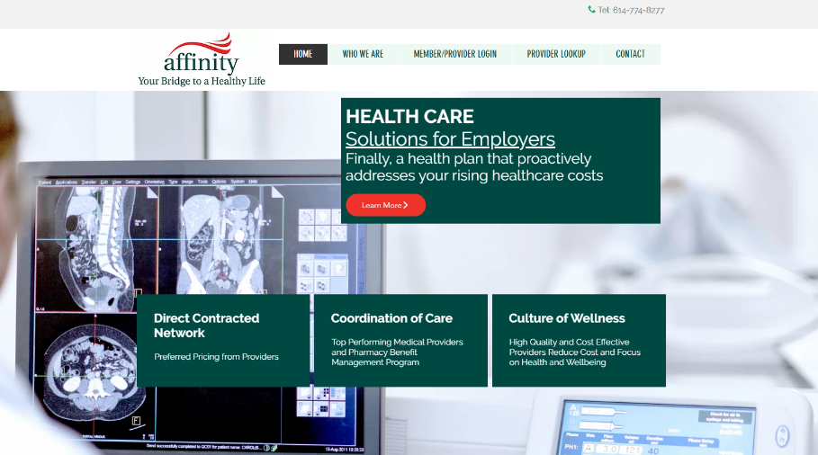








Complete Marketing System
Customized Branding and Messaging
Customized Brochures
Customized Web Site
Targeted Employer Outreach
Sales System (Social Media, Email, Text, etc.)

Slide 19





A Partner You Can Trust
OUR OBJECTIVES ARE ALIGNED
WE KNOW THE
MARKET
COMPLETELY TRANSPARENT
WE HAVE THE SOPHISTICATION AND INFRASTRUCTURE TO EFFECTIVELY COMPETE
Derek Moore, Senior Vice President – KBA
845-283-9973 * derek.moore@keybenefit.com

